Slide 1
CST 205 : MODULE 4
Mrs. Preema Theresa Varghese
Assistant Professor
AI & DS
Sjcet, Palai

Slide 2
Contents
Java Library
String Handling
String Constructors
String Length
Special String Operations
Character Extraction
String Comparison
Searching Strings
Modifying Strings
using valueOf()
Comparison of StringBuffer and String.
Collections framework
Collections overview
Collection Interface
List Interface

Slide 3
Collections Class
ArrayList class
Accessing a Collection via an Iterator
Event handling
Event Handling Mechanisms
Delegation Event Model
Event Classes
Sources of Events
Event Listener Interfaces
Using the Delegation Model
Multithreaded Programming
The Java Thread Model
The Main Thread
Creating Thread
Creating Multiple Threads
Synchronization
Suspending
Resuming
Stopping Threads.

Slide 4
Java Library : String Handling
A string is a sequence of characters
Java implements strings as objects of type String
When you create a String object, you are creating a string that cannot be changed.
That is, once a String object has been created, you cannot change the characters that comprise that string.
You can also declare arrays of strings.
You can use an object of type String as an argument to println( ).
String str = "this is a test";
System.out.println(str);
Here, str is an object of type String. It is assigned the string “this is a test”. This string is displayed by the println( ) statement.

Slide 5
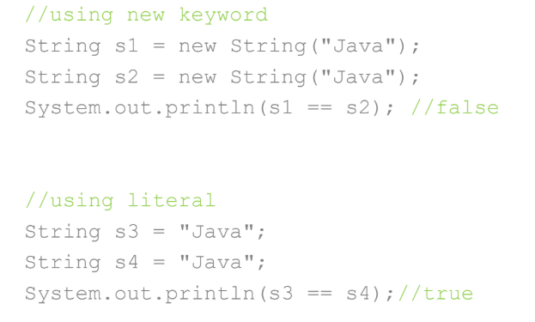
String Creation
There are two ways to create a String in Java
String literal
String name = “hello";
Using new keyword
String str1= new String("Welcome");
Difference Between String Literal & String Object

Slide 6
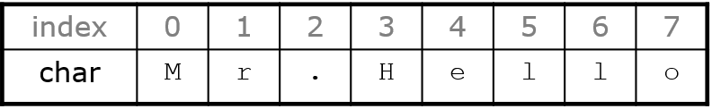
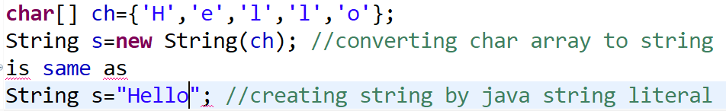
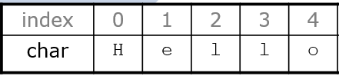
String Basics
Characters of a string are numbered with 0-based indexes:
String name = “Mr.Hello";
The first character's index is always 0
The last character's index is 1 less than the string's length
The individual characters are values of type char
An array of characters works same as Java string. For example:

Slide 7
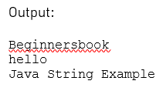
String Creation
public class strex{
public static void main(String args[])
{
//creating a string by java string literal
String str = "Beginnersbook";
System.out.println(str);
char arrch[]={'h','e','l','l','o'};
//converting char array arrch[] to string str2
String str2 = new String(arrch);
System.out.println(str2);
//creating another java string str3 by using new keyword
String str3 = new String("Java String Example");
//Displaying all the three strings
System.out.println(str3);
}
}

Slide 8
String Constructors
The String class supports several constructors.
To create an empty String, you call the default constructor.
For example,
String s = new String();
will create an instance of String with no characters in it.
To create a String initialized by an array of characters, use the constructor shown here:
String(char chars[ ])
Here is an example:
char chars[] = { 'a', 'b', 'c' };
String s = new String(chars);
This constructor initializes s with the string “abc”

Slide 9
You can specify a subrange of a character array as an initializer using the following constructor:
String(char chars[ ], int startIndex, int numChars)
Here, startIndex specifies the index at which the subrange begins, and numChars specifies the number of characters to use.
Here is an example:
char chars[] = { 'a', 'b', 'c', 'd', 'e', 'f' };
String s = new String(chars, 2, 3);
This initializes s with the characters cde.
You can construct a String object that contains the same character sequence as another String object using this constructor:
String(String strObj)
Here, strObj is a String object.

Slide 10
Consider this example:
// Construct one String from another.
class MakeString
{
public static void main(String args[])
{
char c[] = {'J', 'a', 'v', 'a’};
String s1 = new String(c);
String s2 = new String(s1);
System.out.println(s1);
System.out.println(s2);
} }
The output from this program is as follows:
Java
Java

Slide 11
String Length
The length of a string is the number of characters that it contains.
To obtain this value, call the length( ) method, shown here: int length( )
char chars[] = { 'a', 'b', 'c' };
String s = new String(chars);
System.out.println(s.length());
Here the output is 3

Slide 12
Special String Operations
Java has added special support for several string operations within the syntax of the language.
String Literals
String Concatenation
String Concatenation with Other Data Types
String Conversion and toString( )
String Literals
You can use a string literal to initialize a String object.
For example, the following code fragment creates two equivalent strings:
char chars[] = { 'a', 'b', 'c' };
String s1 = new String(chars);
String s2 = "abc"; // use string literal
Because a String object is created for every string literal
For example, you can call methods directly on a quoted string as if it were an object reference, as the following statement shows.

Slide 13
It calls the length( ) method on the string “abc”.
System.out.println("abc".length());
As expected, it prints “3”.
String Concatenation
In general, Java does not allow operators to be applied to String objects.
The one exception to this rule is the + operator, which concatenates two strings, producing a String object as the result.
For example, the following fragment concatenates three strings:
String age = "9";
String s = "He is " + age + " years old.";
System.out.println(s);
This displays the string “He is 9 years old.”
String Concatenation with Other Data Types
You can concatenate strings with other types of data.
For example, consider this slightly different version of the earlier example:

Slide 14
int age = 9;
String s = "He is " + age + " years old.";
System.out.println(s);
In this case, age is an int rather than another String, but the output produced is the same as before.
This is because the int value in age is automatically converted into its string representation within a String object
String s = "four: " + 2 + 2;
System.out.println(s);
This fragment displays four: 22 rather than the four: 4
String s = "four: " + (2 + 2);
Now s contains the string “four: 4”.
String Conversion and toString( )
When Java converts data into its string representation during concatenation, it does so by calling one of the overloaded versions of the string conversion method valueOf( ) defined by String.
valueOf( ) is overloaded for type Object.
For objects, valueOf( ) calls the toString( ) method on the object.
Here you can determine the string representation for objects of classes that you create

Slide 15
Every class implements toString( ) because it is defined by Object.
For most important classes that you create, you will want to override toString( ) and provide your own string representations.
The toString( ) method has this general form:
String toString( )
To implement toString( ), simply return a String object that contains the human-readable string that appropriately describes an object of your class.
By overriding toString( ) for classes that you create, you allow them to be fully integrated into Java’s programming environment.
For example, they can be used in print( ) and println( ) statements and in concatenation expressions.

Slide 16
// Override toString() for Box class.
class Box {
double width;
double height;
double depth;
Box(double w, double h, double d) {
width = w;
height = h;
depth = d; }
public String toString() {
return "Dimensions are " + width + " by " + depth + " by " + height +;
} }
class toStringDemo {
public static void main(String args[]) {
Box b = new Box(10, 12, 14);
System.out.println(b); // convert Box to string
System.out.println(b.toString());
} }
The output of this program is shown here:
Dimensions are 10 by 14 by 12
Dimensions are 10 by 14 by 12

Slide 17
Character Extraction
The String class provides a number of ways in which characters can be extracted from a String object.
charAt( )
To extract a single character from a String, you can refer directly to an individual character via the charAt( ) method. It has this general form:
char charAt(int where)
Here, where is the index of the character that you want to obtain.
The value of where must be nonnegative and specify a location within the string. charAt( ) returns the character at the specified location. For example,
char ch;
ch = "abc".charAt(1);
assigns the value “b” to ch.
getChars( )
If you need to extract more than one character at a time, you can use the getChars( ) method. It has this general form:
void getChars(int sourceStart, int sourceEnd, char target[ ], int targetStart)

Slide 18
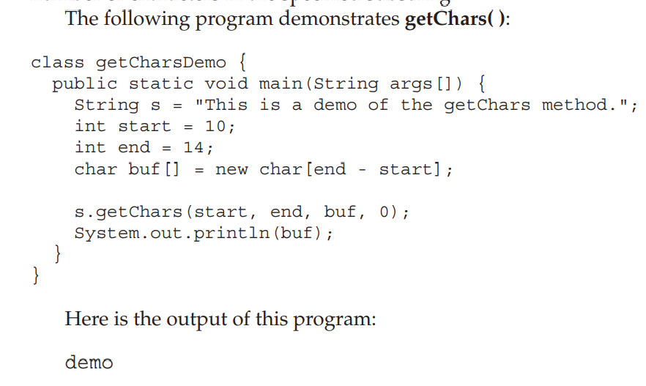
Here, sourceStart specifies the index of the beginning of the substring, and sourceEnd specifies an index that is one past the end of the desired substring.
The array that will receive the characters – is specified by target. The index within target at which the substring will be copied is passed in targetStart

Slide 19
getBytes( )
There is an alternative to getChars( ) that stores the characters in an array of bytes.
This method is called getBytes( ), and it uses the default character-to-byte conversions provided by the platform.
Here is its simplest form:
byte[ ] getBytes( )
toCharArray( )
If you want to convert all the characters in a String object into a character array, the easiest way is to call toCharArray( ).
It returns an array of characters for the entire string.
It has this general form:
char[ ] toCharArray( )

Slide 20
String Comparison
The String class includes several methods that compare strings or substrings within strings.
equals( ) and equalsIgnoreCase( )
To compare two strings for equality, use equals( ).
It has this general form:
boolean equals(Object str)
Here, str is the String object being compared with the invoking String object.
It returns true if the strings contain the same characters in the same order, and false otherwise.
To perform a comparison that ignores case differences, call equalsIgnoreCase( ).
When it compares two strings, it considers A-Z to be the same as a-z.
It has this general form:
boolean equalsIgnoreCase(String str)
Here, str is the String object being compared with the invoking String object.
It, too, returns true if the strings contain the same characters in the same order, and false otherwise.

Slide 21
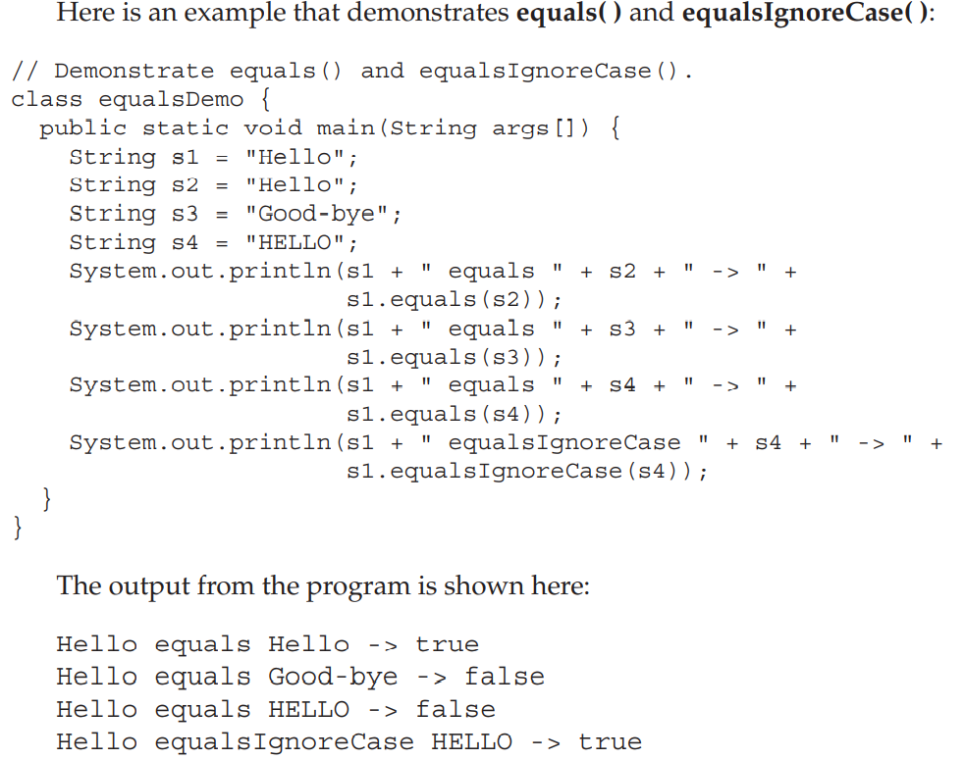

Slide 22
regionMatches( )
The regionMatches( ) method compares a specific region inside a string with another specific region in another string.
There is an overloaded form that allows you to ignore case in such comparisons.
Here are the general forms for these two methods:
boolean regionMatches(int startIndex, String str2, int str2StartIndex, int numChars)
boolean regionMatches(boolean ignoreCase, int startIndex, String str2, int str2StartIndex, int numChars)
For both versions, startIndex specifies the index at which the region begins within the invoking String object.
The String being compared is specified by str2.
The index at which the comparison will start within str2 is specified by str2StartIndex.
The length of the substring being compared is passed in numChars.
In the second version, if ignoreCase is true, the case of the characters is ignored. Otherwise, case is significant.

Slide 23
startsWith( ) and endsWith( )
String defines two routines that are, more or less, specialized forms of regionMatches( ).
The startsWith( ) method determines whether a given String begins with a specified string.
Conversely, endsWith( ) determines whether the String in question ends with a specified string.
They have the following general forms:
boolean startsWith(String str)
boolean endsWith(String str)
Here, str is the String being tested.
If the string matches, true is returned. Otherwise, false is returned.
For example, "Foobar".endsWith("bar") and "Foobar".startsWith("Foo") are both true.
A second form of startsWith( ), shown here, lets you specify a starting point:
boolean startsWith(String str, int startIndex)
Here, startIndex specifies the index into the invoking string at which point the search will begin.
For example, "Foobar".startsWith("bar", 3) returns true.

Slide 24
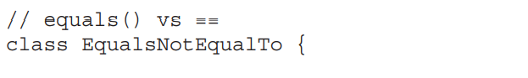
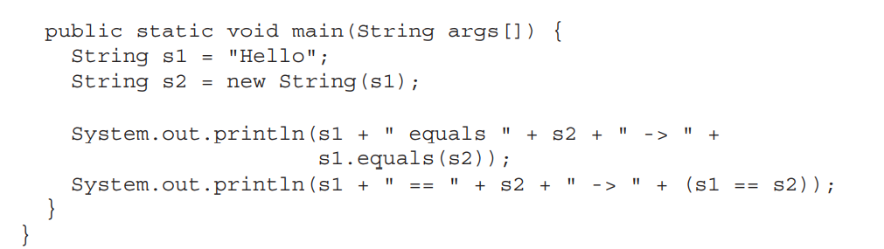
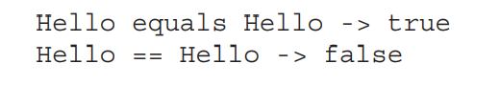
equals( ) Versus ==
It is important to understand that the equals( ) method and the == operator perform two different operations.
The equals( ) method compares the characters inside a String object.
The == operator compares two object references to see whether they refer to the same instance.

Slide 25
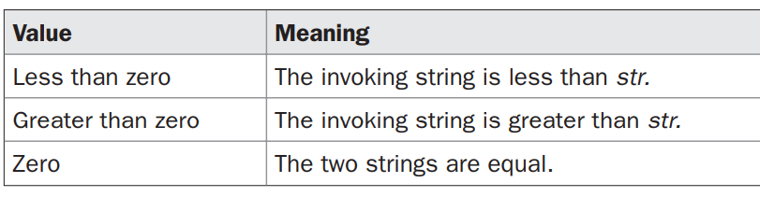
compareTo( )
Often, it is not enough to simply know whether two strings are identical.
For sorting applications, you need to know which is less than, equal to, or greater than the next.
A string is less than another if it comes before the other in dictionary order.
A string is greater than another if it comes after the other in dictionary order.
The String method compareTo( ) serves this purpose.
It has this general form:
int compareTo(String str)
Here, str is the String being compared with the invoking String.
The result of the comparison is returned and is interpreted, as shown here:

Slide 26
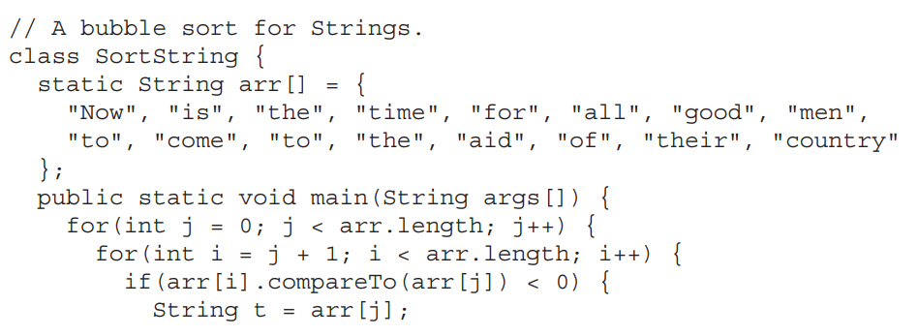
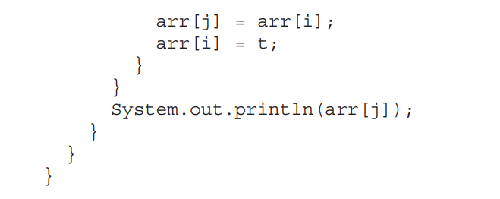

Slide 27
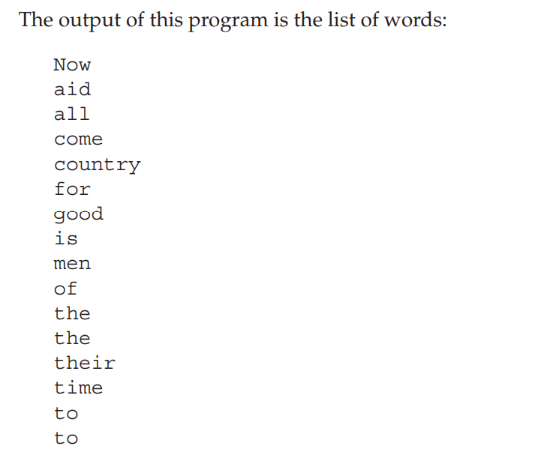
The word “Now” came out before all the others because it begins with an uppercase letter

Slide 28
Searching Strings
The String class provides two methods that allow you to search a string for a specified character or substring:
• indexOf( ) - Searches for the first occurrence of a character or substring.
• lastIndexOf( ) - Searches for the last occurrence of a character or substring.
To search for the first occurrence of a character, use int indexOf(int ch)
To search for the last occurrence of a character, use int lastIndexOf(int ch)
Here, ch is the character being sought.
To search for the first or last occurrence of a substring, use
int indexOf(String str)
int lastIndexOf(String str)
Here, str specifies the substring.

Slide 29
You can specify a starting point for the search using these forms:
int indexOf(int ch, int startIndex)
int lastIndexOf(int ch, int startIndex)
int indexOf(String str, int startIndex)
int lastIndexOf(String str, int startIndex)
Here, startIndex specifies the index at which point the search begins.
For indexOf( ), the search runs from startIndex to the end of the string.
For lastIndexOf( ), the search runs from startIndex to zero.

Slide 30
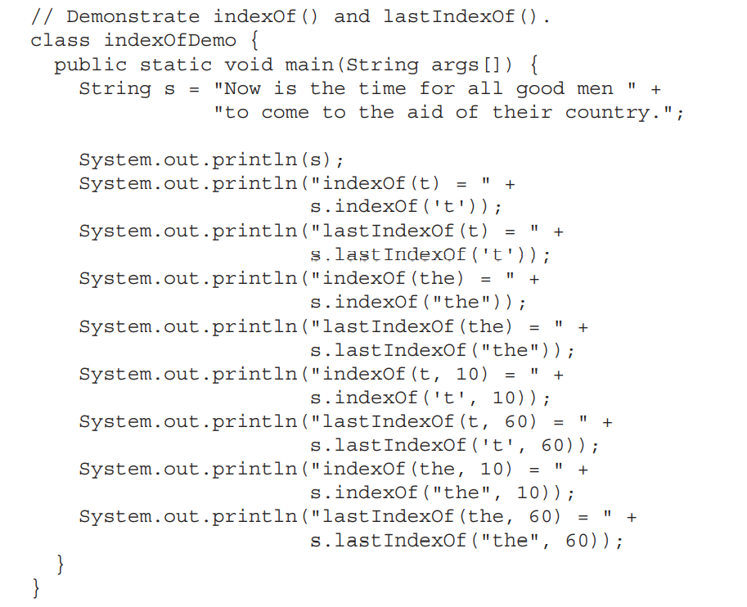

Slide 31
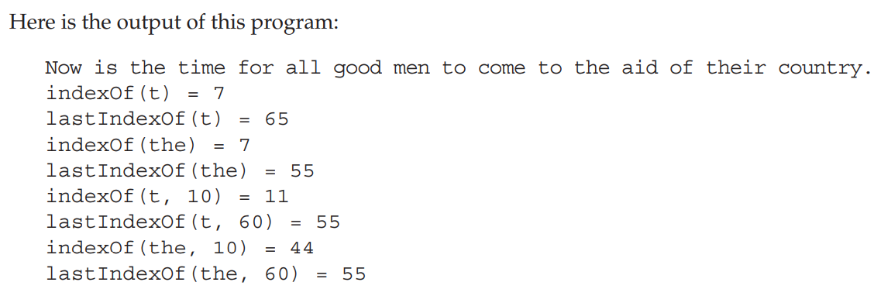

Slide 32
Modifying Strings
Whenever you want to modify a String, you must either copy it into a StringBuffer or StringBuilder, or use one of the following String methods, which will construct a new copy of the string with your modifications complete.
substring( )
You can extract a substring using substring( ). It has two forms.
The first is
String substring(int startIndex)
Here, startIndex specifies the index at which the substring will begin.
This form returns a copy of the substring that begins at startIndex and runs to the end of the invoking string.
The second form of substring( ) allows you to specify both the beginning and ending index of the substring:
String substring(int startIndex, int endIndex)
Here, startIndex specifies the beginning index, and endIndex specifies the stopping point
The string returned contains all the characters from the beginning index, up to, but not including, the ending index.

Slide 33
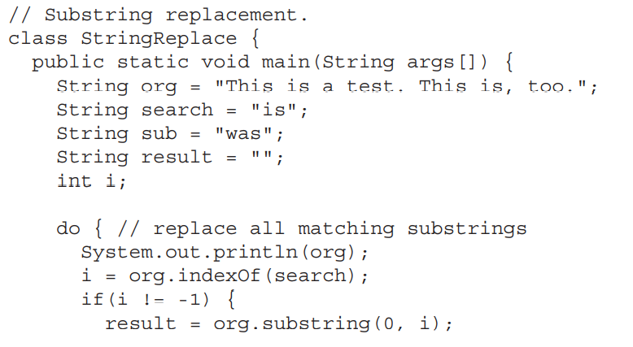
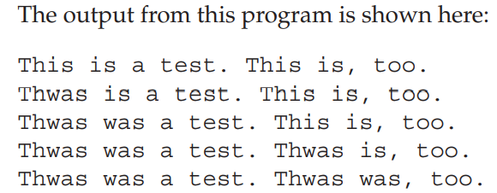
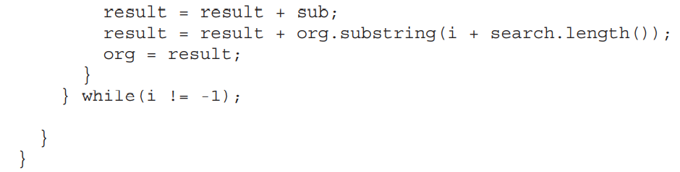

Slide 34
concat( )
You can concatenate two strings using concat( ), shown here:
String concat(String str)
This method creates a new object that contains the invoking string with the contents of str appended to the end.
concat( ) performs the same function as +.
For example,
String s1 = "one";
String s2 = s1.concat("two");
puts the string “onetwo” into s2.
It generates the same result as the following sequence:
String s1 = "one";
String s2 = s1 + "two";

Slide 35
replace( )
The replace( ) method has two forms.
The first replaces all occurrences of one character in the invoking string with another character.
It has the following general form:
String replace(char original, char replacement)
Here, original specifies the character to be replaced by the character specified by replacement.
The resulting string is returned.
For example,
String s = "Hello".replace('l', 'w’);
puts the string “Hewwo” into s.
The second form of replace( ) replaces one character sequence with another.
It has this general form:
String replace(CharSequence original, CharSequence replacement)
For example,
String s = "Hello World".replace(“Hello”, “Hai”);
puts the string “Hai World” into s.

Slide 36
trim( )
The trim( ) method returns a copy of the invoking string from which any leading and trailing whitespace has been removed.
It has this general form:
String trim( )
Here is an example:
String s = " Hello World ".trim();
This puts the string “Hello World” into s.

Slide 37
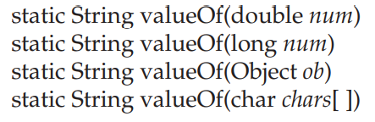
using valueOf()
The valueOf( ) method converts data from its internal format into a human-readable form.
It is a static method that is overloaded within String for all of Java’s built-in types so that eachtype can be converted properly into a string.
valueOf( ) is also overloaded for type Object, so an object of any class type you create can also be used as an argument.
Here are a few of its forms:
valueOf( ) is called when a string representation of some other type of data is needed—for example, during concatenation operations.
You can call this method directly with any data type and get a reasonable String representation.
All of the simple types are converted to their common String representation.

Slide 38
For arrays of char, however, a String object is created that contains the characters in the char array.
There is a special version of valueOf( ) that allows you to specify a subset of a char array.
It has this general form:
static String valueOf(char chars[ ], int startIndex, int numChars)
Here, chars is the array that holds the characters, startIndex is the index into the array of characters at which the desired substring begins, and numChars specifies the length of the substring

Slide 39
Changing the Case of Characters Within a String
The method toLowerCase( ) converts all the characters in a string from uppercase to lowercase.
The toUpperCase( ) method converts all the characters in a string from lowercase to uppercase.
Nonalphabetical characters, such as digits, are unaffected.
Here are the general forms of these methods:
String toLowerCase( )
String toUpperCase( )

Slide 40
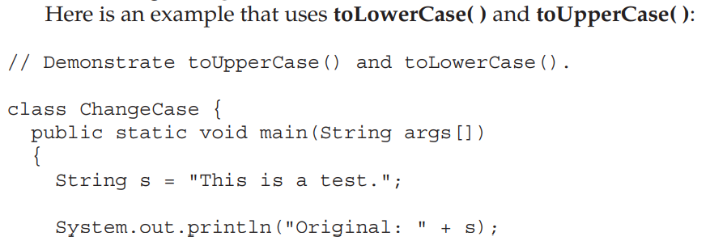
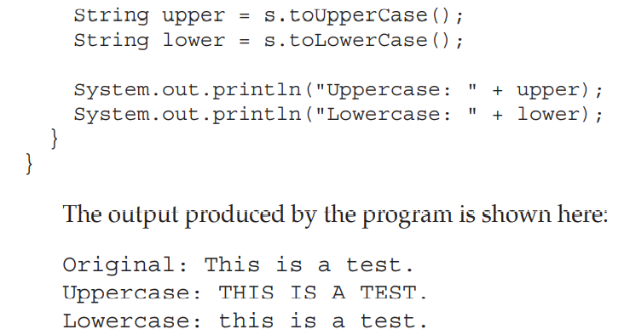

Slide 41
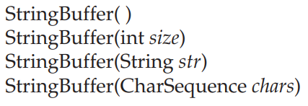
Comparison of StringBuffer and String
StringBuffer is a peer class of String that provides much of the functionality of strings.
String represents fixed-length, immutable character sequences.
StringBuffer represents growable and writeable character sequences.
StringBuffer may have characters and substrings inserted in the middle or appended to the end.
StringBuffer will automatically grow to make room for such additions
StringBuffer Constructors
StringBuffer defines these four constructors:
The default constructor (the one with no parameters) reserves room for 16 characters

Slide 42
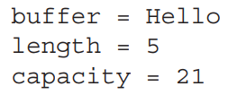
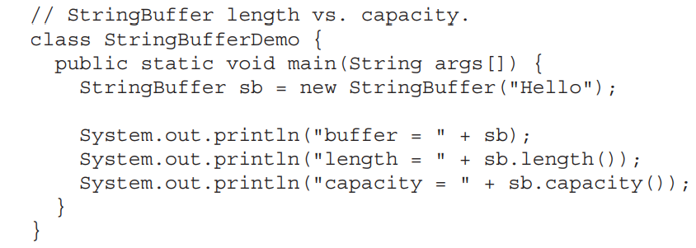
The second version accepts an integer argument that explicitly sets the size of the buffer.
The third version accepts a String argument that sets the initial contents of the StringBuffer object and reserves room for 16 more characters.
The fourth constructor creates an object that contains the character sequence contained in chars.
length( ) and capacity( )
The current length of a StringBuffer can be found via the length( ) method
The total allocated capacity can be found through the capacity( ) method.
They have the following general forms:
int length( ) int capacity( )

Slide 43
ensureCapacity( )
If you want to preallocate room for a certain number of characters after a StringBuffer has been constructed, you can use ensureCapacity( ) to set the size of the buffer.
ensureCapacity( ) has this general form:
void ensureCapacity(int capacity)
Here, capacity specifies the size of the buffer.
setLength( )
To set the length of the buffer within a StringBuffer object, use setLength( ).
Its general form is shown here:
void setLength(int len)
Here, len specifies the length of the buffer. This value must be nonnegative
charAt( ) and setCharAt( )
The value of a single character can be obtained from a StringBuffer via the charAt( ) method.
You can set the value of a character within a StringBuffer using setCharAt( ).
Their general forms are shown here:
char charAt(int where)

Slide 44
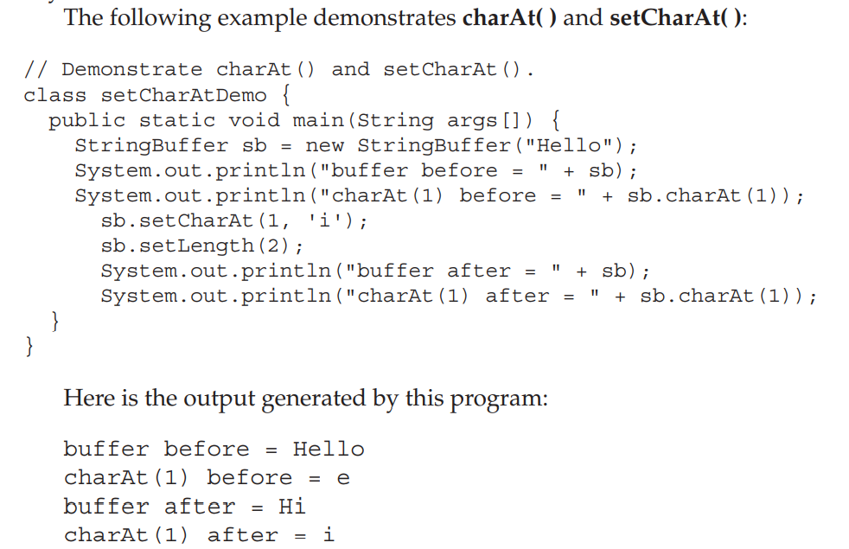
where specifies the index of the character being obtained.
void setCharAt(int where, char ch) For charAt( )
where specifies the index of the character being set, and ch specifies the new value of that character.

Slide 45
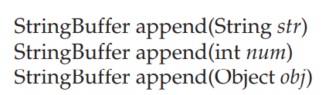
getChars( )
To copy a substring of a StringBuffer into an array, use the getChars( ) method.
It has this general form:
void getChars(int sourceStart, int sourceEnd, char target[ ], int targetStart)
Here, sourceStart specifies the index of the beginning of the substring, and sourceEnd specifies an index that is one past the end of the desired substring.
The array that will receive the characters is specified by target. The index within target at which the substring will be copied is passed in targetStart.
append( )
The append( ) method concatenates the string representation of any other type of data to the end of the invoking StringBuffer object.
Different forms are:

Slide 46
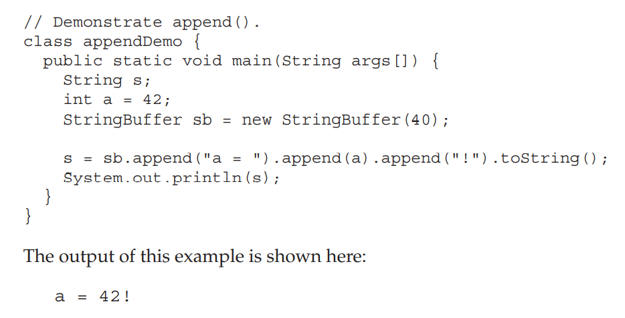

Slide 47
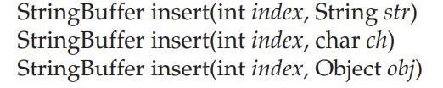
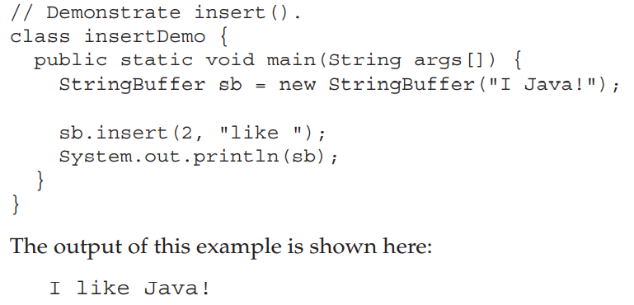
insert( )
The insert( ) method inserts one string into another
These are a few of its forms:
Here, index specifies the index at which point the string will be inserted into the invoking StringBuffer object

Slide 48
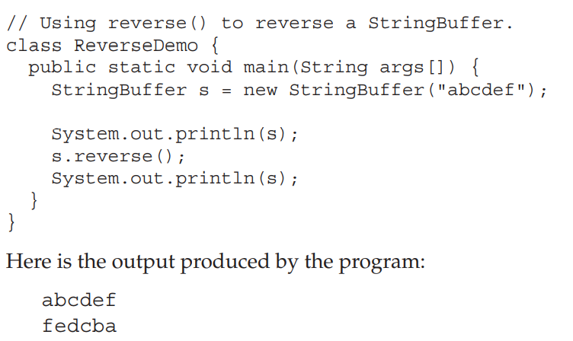
reverse( )
You can reverse the characters within a StringBuffer object using reverse( ), shown here:
StringBuffer reverse( )

Slide 49
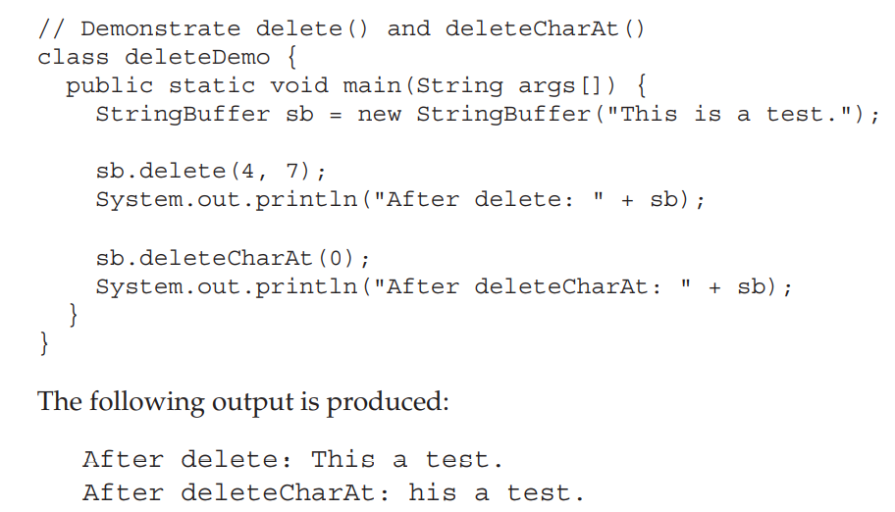
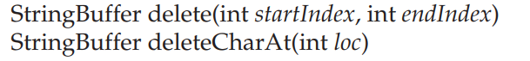
delete( ) and deleteCharAt( )
The delete( ) method deletes a sequence of characters from the invoking object.
Here, startIndex specifies the index of the first character to remove, and endIndex specifies an index one past the last character to remove.
The deleteCharAt( ) method deletes the character at the index specified by loc.
These methods are shown here:

Slide 50
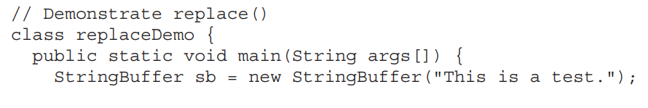
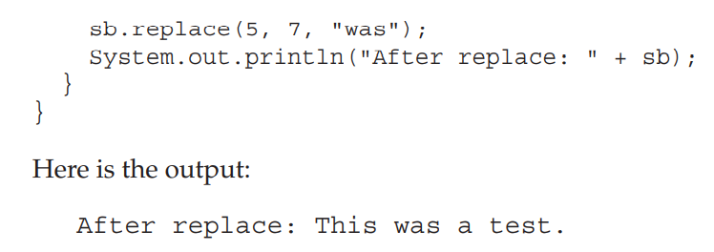
replace( )
To replace one set of characters with another set inside a StringBuffer object
Its signature is shown here:
StringBuffer replace(int startIndex, int endIndex, String str)
The substring being replaced is specified by the indexes startIndex and endIndex.
The replacement string is passed in str.

Slide 51
Collections framework : Collections overview
Java collections
Java collections refer to a collection of individual objects that are represented as a single unit.
You can perform all operations such as searching, sorting, insertion, manipulation, deletion, etc., on Java collections just like you do it on data.
Java Collection Framework
A Java collection framework provides an architecture to store and manipulate a group of objects.
A Java collection framework includes the following:
Interfaces
Classes
Algorithm

Slide 52
Why use Java collection?
There are several benefits of using Java collections such as:
Reducing the effort required to write the code by providing useful data structures and algorithms
Java collections provide high-performance and high-quality data structures and algorithms thereby increasing the speed and quality
Unrelated APIs can pass collection interfaces back and forth
Decreases extra effort required to learn, use, and design new API’s
Supports reusability of standard data structures and algorithms
Hierarchy of Collection Framework
The java.util package contains all the classes and interfaces for the Collection framework.

Slide 53
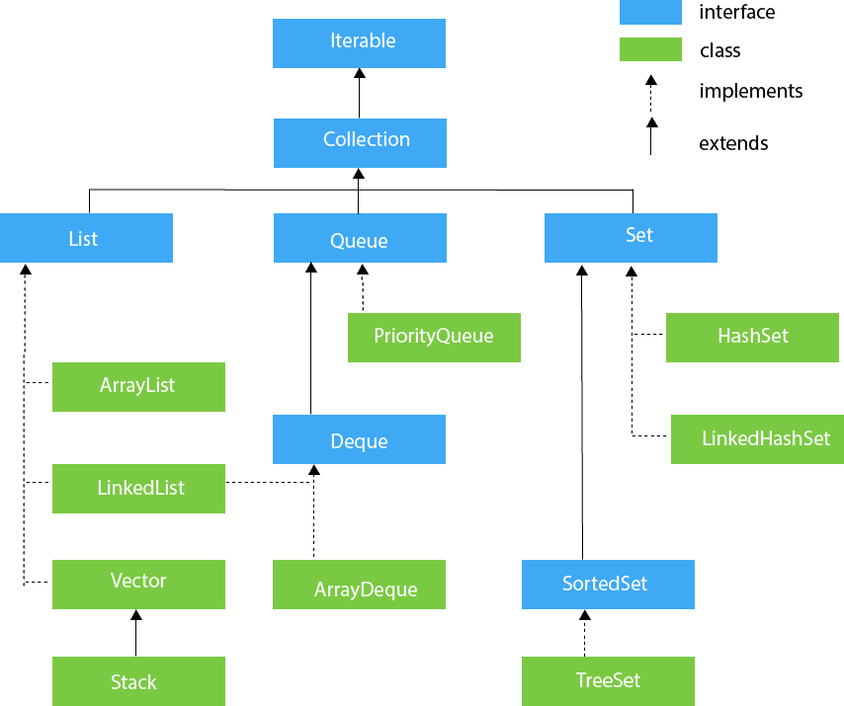

Slide 54
Collections Interface
The Collection interface is the root interface of the Java collections framework.
There is no direct implementation of this interface. However, it is implemented through its subinterfaces like List, Set, and Queue.
For example, the ArrayList class implements the List interface which is a subinterface of the Collection Interface.
Subinterfaces of Collection
The Collection interface includes subinterfaces that are implemented by various classes in Java.
List Interface
is an ordered collection that allows us to add and remove elements like an array.
Set Interface
Allows us to store elements in different sets similar to the set in mathematics. It cannot have duplicate elements.
Queue Interface
is used when we want to store and access elements in First In, First Out(FIFO) manner.

Slide 55
Methods of Collection
The Collection interface includes various methods that can be used to perform different operations on objects.
These methods are available in all its subinterfaces.
add() - inserts the specified element to the collection
size() - returns the size of the collection
remove() - removes the specified element from the collection
iterator() - returns an iterator to access elements of the collection
addAll() - adds all the elements of a specified collection to the collection
removeAll() - removes all the elements of the specified collection from the collection
clear() - removes all the elements of the collection

Slide 56
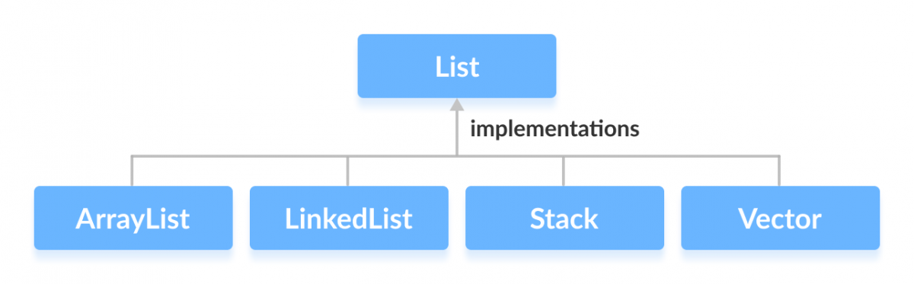
List Interface
In Java, the List interface is an ordered collection that allows us to store and access elements sequentially.
It extends the Collection interface.
Classes that Implement List
Since List is an interface, we cannot create objects from it.
In order to use functionalities of the List interface, we can use these classes:
ArrayList
LinkedList
Vector
Stack

Slide 57
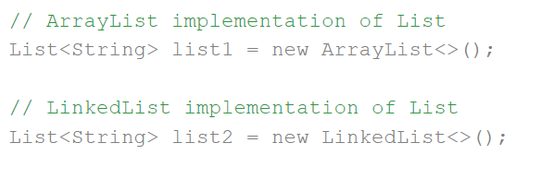
How to use List?
In Java, we must import java.util.List package in order to use List.
Here, we have created objects list1 and list2 of classes ArrayList and LinkedList.
These objects can use the functionalities of the List interface.

Slide 58
Methods of List
The List interface includes all the methods of the Collection interface. Its because Collection is a super interface of List.
Some of the commonly used methods of the Collection interface that's also available in the List interface are:
add() - adds an element to a list
addAll() - adds all elements of one list to another
get() - helps to randomly access elements from lists
iterator() - returns iterator object that can be used to sequentially access elements of lists
set() - changes elements of lists
remove() - removes an element from the list
removeAll() - removes all the elements from the list
clear() - removes all the elements from the list (more efficient than removeAll())
size() - returns the length of lists
toArray() - converts a list into an array
contains() - returns true if a list contains specified element

Slide 59
Collections Class
Classes that Implement List
Since List is an interface, we cannot create objects from it.
In order to use functionalities of the List interface, we can use these classes:
ArrayList
LinkedList
Vector
Stack

Slide 60
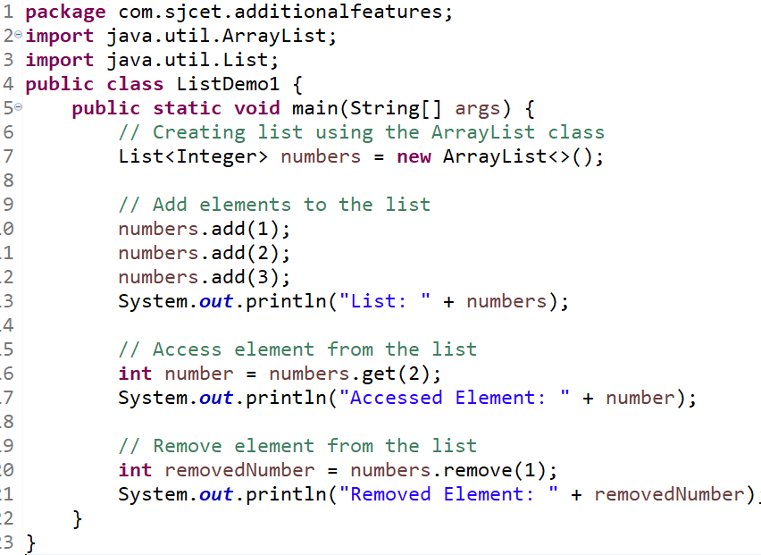
Implementation of the List Interface - ArrayList Class
Output
List: [1, 2, 3]
Accessed Element: 3
Removed Element: 2

Slide 61
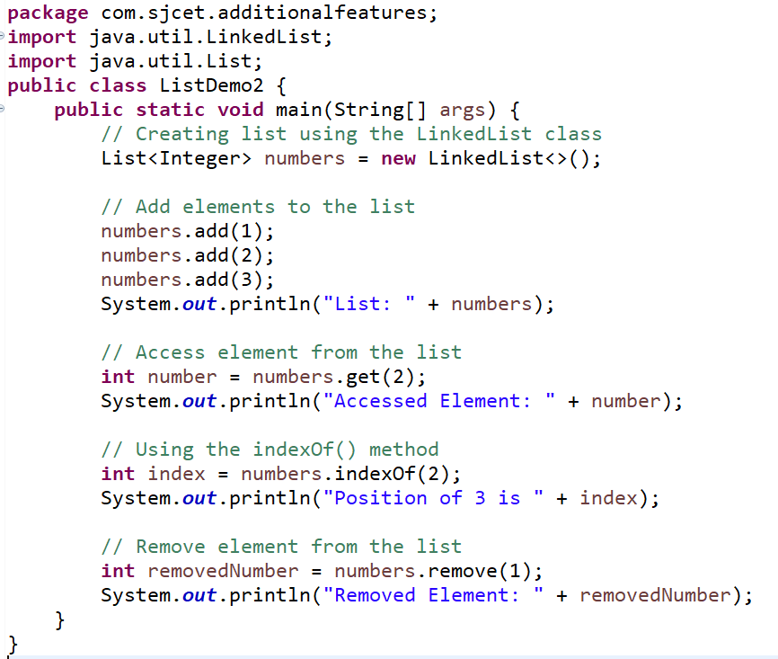
Implementation of the List Interface - LinkedList Class
Output
List: [1, 2, 3]
Accessed Element: 3
Position of 3 is 2
Removed Element: 2

Slide 62
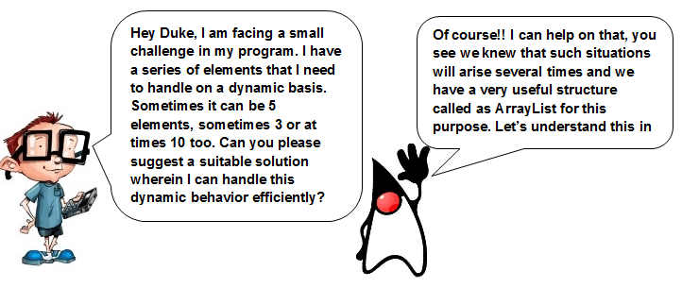
ArrayList class

Slide 63
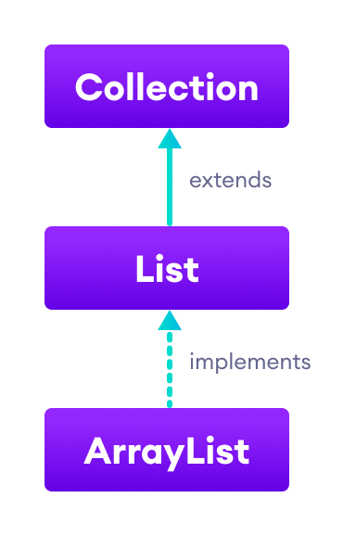
The ArrayList class of the Java collections framework provides the functionality of resizable-arrays.
It implements the List interface.

Slide 64
Creating an ArrayList
Before using ArrayList, we need to import the java.util.ArrayList package first.
ArrayList<Type> arrayList= new ArrayList<>();
Here, Type indicates the type of an arraylist. For example
// create Integer type arraylist
ArrayList<Integer> arrayList = new ArrayList<>();
// create String type arraylist
ArrayList<String> arrayList = new ArrayList<>();
Note: In the above program, we have used Integer not int. It is because we cannot use primitive types while creating an arraylist. Instead, we have to use the corresponding wrapper classes. Here, Integer is the corresponding wrapper class of int.

Slide 65
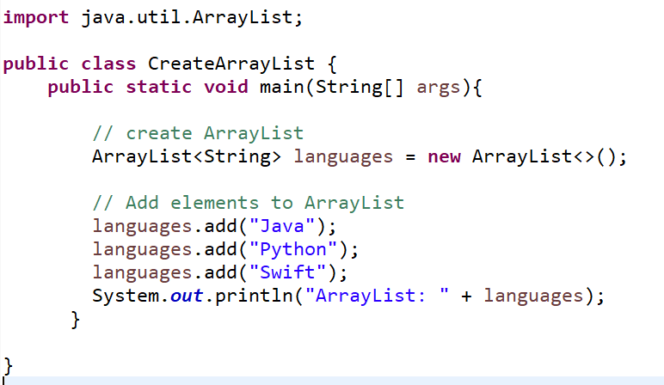
Example: Create ArrayList in Java
Output
ArrayList: [Java, Python, Swift]

Slide 66
Basic Operations on Java ArrayList
The ArrayList class provides various methods to perform different operations on arraylists.
Some of the commonly used arraylist operations are:
Add elements
Access elements
Change elements
Remove elements
Adding Elements on Java ArrayList
add(Object): This method is used to add an element at the end of the ArrayList.
add(int index, Object): This method is used to add an element at a specific index in the ArrayList.
boolean addAll(Collection c): This method appends all of the elements in the specified collection to the end of this list, in the order that they are returned by the specified collection’s Iterator.
boolean addAll(int index, Collection c): This method inserts all of the elements in the specified collection into this list, starting at the specified position.

Slide 67
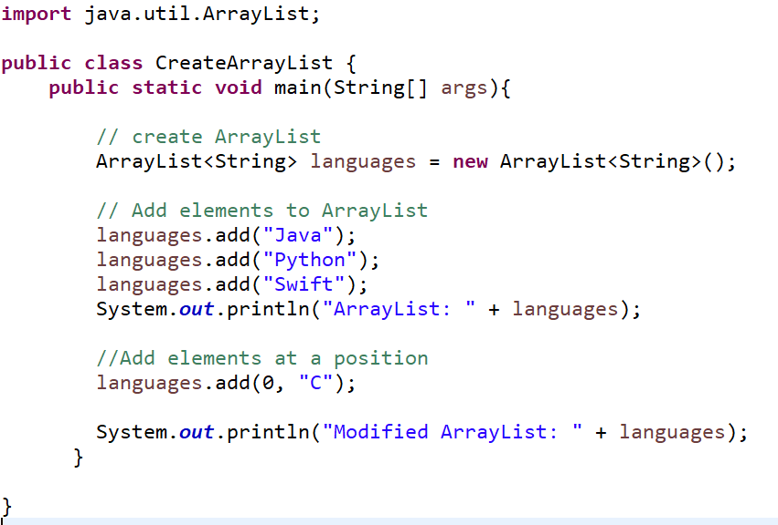
add(Object) & add(int index, Object) Demo
Output
ArrayList: [Java, Python, Swift]
Modified ArrayList: [C, Java, Python, Swift]

Slide 68
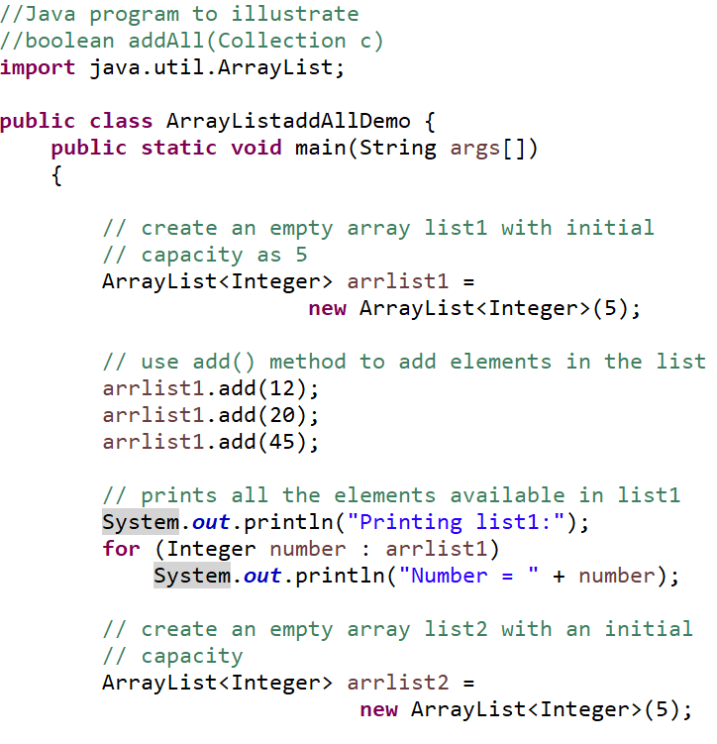
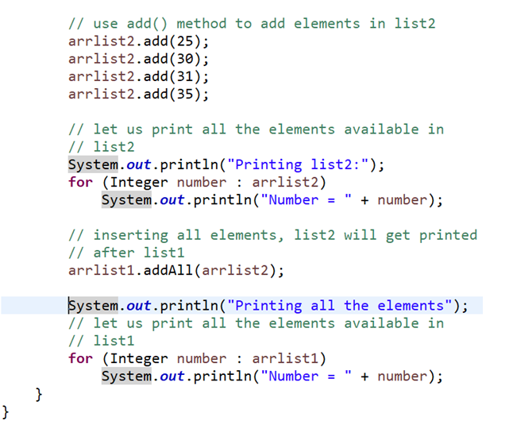
addAll(Collection c): Demo

Slide 69
Output
Printing list1:
Number = 12
Number = 20
Number = 45
Printing list2:
Number = 25
Number = 30
Number = 31
Number = 35
Printing all the elements
Number = 12
Number = 20
Number = 45
Number = 25
Number = 30
Number = 31
Number = 35

Slide 70
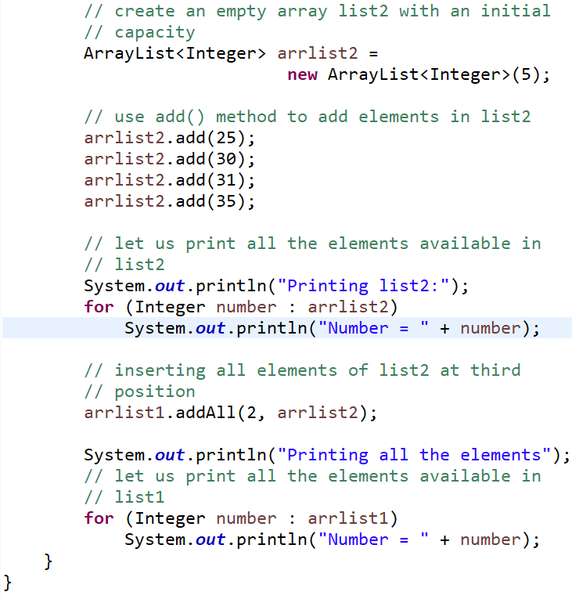
boolean addAll(int index, Collection c):Demo

Slide 71
Printing list1:
Number = 12
Number = 20
Number = 45
Printing list2:
Number = 25
Number = 30
Number = 31
Number = 35
Printing all the elements
Number = 12
Number = 20
Number = 25
Number = 30
Number = 31
Number = 35
Number = 45

Slide 72
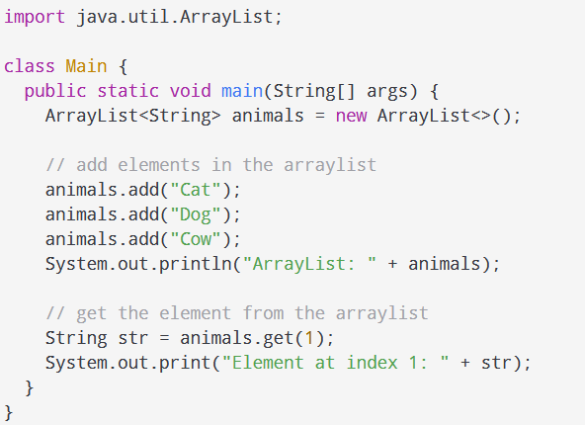
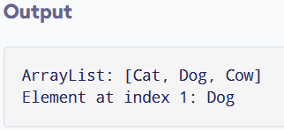
Access ArrayList Elements
To access an element from the arraylist, we use the get() method of the ArrayList class.

Slide 73
Accessing a Collection via an Iterator
Java ArrayList iterator() - returns an iterator to access each element of the arraylist in a proper sequence.

Slide 74
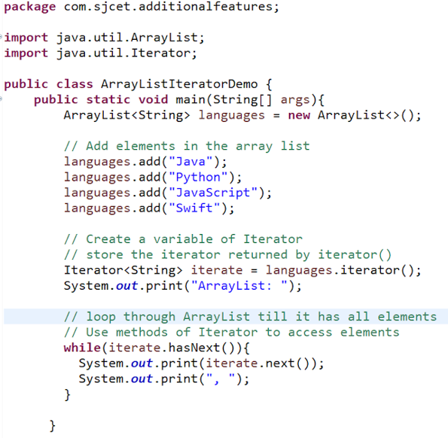

Java: 0
Python: 1
JavaScript: 2
Swift: 3

Slide 75
Change ArrayList Elements
The Java ArrayList set() method replaces the element present in a specified position with the specified element in an arraylist.
The syntax of the set() method is:
arraylist.set(int index, E element)
Here, arraylist is an object of the ArrayList class.
index - position of the element to be replaced
element - new element that is to be stored at index
throws IndexOutOfBoundsException, if index is out of range

Slide 76

Change ArrayList Elements Demo

Slide 77
Remove ArrayList Elements
To remove an element from the arraylist, we can use the
remove()
removeAll()
clear()
Remove ArrayList Elements
To remove an element from the arraylist using remove()
Method remove(int index) is used for removing an element of the specified index from a list. It
Removes an element and returns the same.
It throws IndexOutOfBoundsException if the specified index is less than zero or greater than the size of the list

Slide 78


Slide 79
To remove elements from the arraylist using removeAll()
The Java ArrayList removeAll() method removes all the elements from the arraylist that are also present in the specified collection.
The syntax of the removeAll() method is
arraylist.removeAll(Collection c);
Here, arraylist is an object of the ArrayList class.
returns true if elements are deleted from the arraylist
throws ClassCastException if the class of elements present in arraylist is incompatible with the class of elements in specified collection
throws NullPointerException if the arraylist contains null element and the specified collection does not allow null elements

Slide 80

Output
Programming Languages: [Java, JavaScript, Python]
ArrayList after removeAll(): []

Slide 81

To remove elements from the arraylist using clear()
The java.util.ArrayList.clear() method removes all of the elements from this list.
The list will be empty after this call returns.
Output
Programming Languages: [Java, JavaScript, Python]
ArrayList after removeAll(): []

Slide 82

Remove all Elements from an ArrayList Present in Another ArrayList

Slide 83


Sort the ArrayList

Slide 84



Slide 85

Event handling : Event Handling Mechanisms
Event – Change in state of an object or source
Event Handling: the mechanism that controls the event and decides what should happen if an event occurs
A source generates an event and sends it to one or more listeners.
In this scheme, the listener simply waits until it receives an event.
Once an event is received, the listener processes the event and then returns.

Slide 86
Events are supported by a number of packages, including
java.util
java.awt
java.awt.event
Applets are event-driven programs that use a graphical user interface(GUI) to interact with the user.
Any program that uses a graphical user interface is event driven.

Slide 87
Delegation Event Model
In the delegation model, an event is an object that describes a state change in a source.
Can be generated due to a user interacting with the elements in a graphical user interface.
pressing a button, entering a character via the keyboard, selecting an item in a list, and clicking the mouse.
May also occur that are not directly caused by interactions with a user interface.
a timer expires, a counter exceeds a value, a software or hardware failure occurs, or an operation is completed

Slide 88
The Delegation Event Model - Event Sources
A source is an object that generates an event
This occurs when the internal state of that object changes in some way.
Sources may generate more than one type of event.
Source must register listeners in order for the listeners to receive notifications about a specific type of event.
Each type of event has its own registration method.
Here is the general form:
public void addTypeListener (TypeListener el )
Here, Type is the name of the event, and el is a reference to the event listener.
Example : addKeyListener() - method that registers a keyboard event listener

Slide 89
When an event occurs, all registered listeners are notified and receive a copy of the event object.
This is known as multicasting the event.
unicasting is also possible in JAVA
A source must also provide a method that allows a listener to unregister an interest in a specific type of event.
The general form of such a method is this:
public void removeTypeListener(TypeListener el )
Example: removeKeyListener( )

Slide 90
The Delegation Event Model - Event Listeners
A listener is an object that is notified when an event occurs.
It has two major requirements.
First, it must have been registered with one or more sources to receive notifications about specific types of events.
Second, it must implement methods to receive and process these notifications.
The methods that receive and process events are defined in a set of interfaces, such as those found in java.awt.event.
For example, the MouseMotionListener interface defines two methods to receive notifications when the mouse is dragged or moved.
Any object may receive and process one or both of these events if it provides an implementation of this interface.

Slide 91
Event Classes
The classes that represent events(Event classes) are at the core of Java’s event handling mechanism.
The most widely used events are those defined by the AWT and by the Swing.
At the root of the Java event class hierarchy is EventObject, which is in java.util. EventObject is the superclass for all events.
EventObject contains two methods:
getSource( )-getSource( ) method returns the source of the event.
toString( )- toString( ) returns the string equivalent of the event.
The class AWTEvent, defined within the java.awt package, is a subclass of EventObject.
Its getID( ) method can be used to determine the type of the event.

Slide 92


Event Class Hierarchy
when a check box or list item is clicked
when a choice selection is made
checkable menu item is selected or deselected.

Slide 93


Generated when a scroll bar is manipulated.

Slide 94


Slide 95
when a component is hidden, moved, resized, or becomes visible.
The root event class for all component-level input events.
when the mouse is dragged, moved, clicked, pressed, or released;
when the mouse enters or exits a component.
when input is received from the keyboard.

Slide 96

when a button is pressed, a list item is double-clicked, or a menu item is selected.

Slide 97
Generated when the value of a text area or text field is changed.

Slide 98
The ActionEvent Class
An ActionEvent is generated when a
button is pressed
a list item is double-clicked
a menu item is selected.
The ActionEvent class defines four integer constants that can be used to identify any modifiers associated with an action event
ALT_MASK
CTRL_MASK
META_MASK
SHIFT_MASK
In addition, there is an integer constant, ACTION_PERFORMED, which can be used to identify action events.
You can obtain the command name for the invoking ActionEvent object by using the getActionCommand() method.
The getModifiers() method returns a value that indicates which modifier keys (alt, ctrl, meta, and/or shift) were pressed when the event was generated.

Slide 99



Slide 100
The AdjustmentEvent Class
The adjustment event emitted by Adjustable objects like Scrollbar and ScrollPane.
When the user changes the value of the scrolling component, it receives an instance of AdjustmentEvent.
An unspecified behavior will be caused if the id parameter of any particular AdjustmentEvent instance is not in the range from ADJUSTMENT_FIRST to ADJUSTMENT_LAST.
The type of any AdjustmentEvent instance takes one of the following values:
UNIT_INCREMENT
UNIT_DECREMENT
BLOCK_INCREMENT
BLOCK_DECREMENT
TRACK
In addition, there is an integer constant, ADJUSTMENT_VALUE_CHANGED, that indicates that a change has occurred.
The getAdjustable( ) method returns the object that generated the event.
The type of the adjustment event may be obtained by the getAdjustmentType( ) method. It returns one of the constants defined by AdjustmentEvent.

Slide 101


Slide 102
The ComponentEvent Class
A ComponentEvent is generated when the size, position, or visibility of a component is changed.
There are four types of component events.
COMPONENT_HIDDEN : The component was hidden.
COMPONENT_MOVED : The component was moved.
COMPONENT_RESIZED : The component was resized.
COMPONENT_SHOWN : The component became visible.
ComponentEvent is the superclass either directly or indirectly of ContainerEvent
FocusEvent, KeyEvent, MouseEvent, and WindowEvent, among others.

Slide 103
The ContainerEvent Class
A ContainerEvent is generated when a component is added to or removed from a container. There are two types of container events.
The ContainerEvent class defines int constants that can be used to identify them: COMPONENT_ADDED and COMPONENT_REMOVED.
They indicate that a component has been added to or removed from the container.
ContainerEvent is a subclass of ComponentEvent
You can obtain a reference to the container that generated this event by using the getContainer ( ) method

Slide 104
The FocusEvent Class
A FocusEvent is generated when a component gains or loses input focus.
These events are identified by the integer constants FOCUS_GAINED and FOCUS_LOST.
FocusEvent is a subclass of ComponentEvent
The InputEvent Class
The abstract class InputEvent is a subclass of ComponentEvent and is the superclass for component input events.
Its subclasses are KeyEvent and MouseEvent.
InputEvent defines several integer constants that represent any modifiers, such as the control key being pressed, that might be associated with the event.
Originally, the InputEvent class defined the following eight values to repres ent the modifiers:
ALT_MASK ALT_GRAPH_MASK BUTTON1_MASK BUTTON2_MASK
BUTTON3_MASK CTRL_MASK META_MASK SHIFT_MASK

Slide 105
However, because of possible conflicts between the modifiers used by keyboard events and mouse events, and other issues, the following extended modifier values were added:
ALT_DOWN_MASK ALT_GRAPH_DOWN_MASK
BUTTON1_DOWN_MASK BUTTON2_DOWN_MASK
BUTTON3_DOWN_MASK CTRL_DOWN_MASK
META_DOWN_MASK SHIFT_DOWN_MASK
You can obtain a value that contains all of the original modifier flags by calling the getModifiers( ) method.
You can obtain the extended modifiers by calling getModifiersEx( )

Slide 106
The ItemEvent Class
An ItemEvent is generated when a check box or a list item is clicked or when a checkable menu item is selected or deselected.
There are two types of item events, which are identified by the following integer constants:
DESELECTED : The user deselected an item.
SELECTED : The user selected an item.
In addition, ItemEvent defines one integer constant, ITEM_STATE_CHANGED, that signifies a change of state.
The getItem( ) method can be used to obtain a reference to the item that changed.
The getItemSelectable( ) method can be used to obtain a reference to the ItemSelectable object that generated an event.
The getStateChange( ) method returns the state change (that is, SELECTED or DESELECTED) for the event.

Slide 107
KeyEvent class
A KeyEvent is generated when keyboard input occurs.
There are three types of key events, which are identified by these integer constants:
KEY_PRESSED
KEY_RELEASED
KEY_TYPED.
The first two events are generated when any key is pressed or released.
The last event occurs only when a character is generated.
There are many other integer constants that are defined by KeyEvent.
For example, VK_0 through VK_9 define the ASCII equivalents of the numbers. – VK_A through VK_Z define the ASCII equivalents of the letters.
The KeyEvent class defines several methods,
char getKeyChar( ), which returns the character that was entered,
int getKeyCode( ), which returns the key code.

Slide 108
MouseEvent Class
There are eight types of mouse events. The MouseEvent class defines the integer constants to identify them: .
MOUSE_CLICKED -> user clicked the mouse.
MOUSE_DRAGGED -> user dragged the mouse.
MOUSE_ENTERED -> mouse entered entered a component.
MOUSE_EXITED -> mouse exited from a component.
MOUSE_MOVED -> mouse moved
MOUSE_PRESSED->mouse was pressed.
MOUSE_RELEASED->mouse was released.
MOUSE_WHEEL->mouse wheel was moved.
Two commonly used methods in this class are
int getX( ) -return the X coordinate
int getY( ) - return the Y coordinate
Point getPoint( ) method - to obtain the coordinates of the mouse.
returns a Point object that contains the X,Y coordinates in its integer members: x and y

Slide 109
int getButton( ) method- returns a value that represents the button that caused the event. Return value will be one of these constants defined by MouseEvent:
NOBUTTON- indicates that no button was pressed or released.
BUTTON1
BUTTON2
BUTTON3
TextEvent class
Instances of TextEvent class describe text events.
These are generated by text fields and text areas when characters are entered by a user or program.
TextEvent defines the integer constant TEXT_VALUE_CHANGED

Slide 110
WindowEvent Class
There are ten types of window events.
The WindowEvent class defines integer constants that can be used to
WINDOW_ACTIVATED
WINDOW_CLOSED
WINDOW_CLOSING
WINDOW_DEACTIVATED
WINDOW_DEICONIFIED
WINDOW_FIRST
WINDOW_GAINED_FOCUS
WINDOW_ICONIFIED
WINDOW_LOST_FOCUS
WINDOW_STATE_CHANGED
A commonly used method in this class is getWindow( ).
getWindow( ) returns the Window object that generated the event.
WindowEvent also defines methods that return the opposite window (when a focus or activation event has occurred) – Window getOppositeWindow()
The previous window state - int getOldState()
The current window state – int getnewState()

Slide 111

Sources of Events

Slide 112
Event Listener Interfaces
MouseMotionListener Interface
The Java MouseMotionListener is notified whenever you move or drag mouse.
It is notified against MouseEvent.
The MouseMotionListener interface is found in java.awt.event package.
The signature of 2 methods found in MouseMotionListener interface are given below:
public abstract void mouseDragged(MouseEvent e);
public abstract void mouseMoved(MouseEvent e);

Slide 113
Java MouseListener Interface
Java MouseListener is notified whenever you change the state of mouse.
It is notified against MouseEvent.
The MouseListener interface is found in java.awt.event package.
The signature of 5 methods found in MouseListener interface are given below:
public abstract void mouseClicked(MouseEvent e);
public abstract void mouseEntered(MouseEvent e);
public abstract void mouseExited(MouseEvent e);
public abstract void mousePressed(MouseEvent e);
public abstract void mouseReleased(MouseEvent e);

Slide 114
Java KeyListener Interface
The Java KeyListener is notified whenever you change the state of key.
It is notified against KeyEvent.
The KeyListener interface is found in java.awt.event package.
It has three methods
public abstract void keyPressed(KeyEvent e);
public abstract void keyReleased(KeyEvent e);
public abstract void keyTyped(KeyEvent e);

Slide 115
Java ActionListener Interface
The Java ActionListener is notified whenever you click on the button or menu item.
It is notified against ActionEvent.
The ActionListener interface is found in java.awt.event package.
It has only one method: actionPerformed().
actionPerformed() method
The actionPerformed() method is invoked automatically whenever you click on the registered component.
public abstract void actionPerformed(ActionEvent e);

Slide 116
Java WindowListener Interface
The Java WindowListener is notified whenever you change the state of window.
It is notified against WindowEvent.
The WindowListener interface is found in java.awt.event package.
It has seven methods.
void windowActivated(WindowEvent e) - Invoked when the Window is set to be the active Window.
void windowClosed(WindowEvent e) - Invoked when a window has been closed as the result of calling dispose on the window.

Slide 117
void windowClosing(WindowEvent e)- Invoked when the user attempts to close the window from the window's system menu.
void windowDeactivated(WindowEvent e) - Invoked when a Window is no longer the active Window.
void windowDeiconified(WindowEvent e) - Invoked when a window is changed from a minimized to a normal state.
void windowIconified(WindowEvent e) - Invoked when a window is changed from a normal to a minimized state.
void windowOpened(WindowEvent e) - Invoked the first time a window is made visible.

Slide 118
Java ItemListener Interface
The Java ItemListener is notified whenever you click on the checkbox.
It is notified against ItemEvent.
The ItemListener interface is found in java.awt.event package.
It has only one method: itemStateChanged().
itemStateChanged() method
The itemStateChanged() method is invoked automatically whenever you click or unclick on the registered checkbox component.
public abstract void itemStateChanged(ItemEvent e);

Slide 119
Using the Delegation Model
Using the delegation event model is actually quite easy.
Just follow these two steps:
1. Implement the appropriate interface in the listener so that it will receive the type of event desired.
2. Implement code to register and unregister (if necessary) the listener as a recipient for the event notifications.
A source may generate several types of events.
Each event must be registered separately.
Also, an object may register to receive several types of events, but it must implement all of the interfaces that are required to receive these events
Look at examples that handle two commonly used event generators: the mouse and keyboard

Slide 120

Handling Mouse Events
To handle mouse events, you must implement the MouseListener and the MouseMotionListener interfaces.

Slide 121



Slide 122


Slide 123

Handling Keyboard Events
To handle keyboard events use the KeyListener interface.

Slide 124


Slide 125


Slide 126
Multithreaded Programming
Java provides built-in support for multithreaded programming.
A multithreaded program contains two or more parts that can run concurrently.
Each part of such a program is called a thread, and each thread defines a separate path of execution.
Thus, multithreading is a specialized form of multitasking.
MULTITHREADING in Java is a process of executing two or more threads simultaneously to maximum utilization of CPU.
Multithreaded applications execute two or more threads run concurrently. Hence, it is also known as Concurrency in Java.
Why Multithreading?
Better utilization of a single CPU.
Better utilization of multiple CPUs or CPU cores.
Better user experience

Slide 127


Slide 128
The Java Thread Model
A thread is a light-weight smallest part of a process that can run concurrently with the other parts(other threads) of the same process.
Threads are independent
Single-threaded systems use an approach called an event loop with polling.
In this model, a single thread of control runs in an infinite loop, polling a single event queue to decide what to do next. Once this polling mechanism returns with, say, a signal that a network file is ready to be read, then the event loop dispatches control to the appropriate event handler. Until this event handler returns, nothing else can happen in the system.
This wastes CPU time. It can also result in one part of a program dominating the system and preventing any other events from being processed.
In general, in a singled-threaded environment, when a thread blocks (that is, suspends execution) because it is waiting for some resource, the entire program stops running.
The benefit of Java’s multithreading is that the main loop/polling mechanism is eliminated.
One thread can pause without stopping other parts of your program.

Slide 129
Threads exist in several states.
A thread can be running.
It can be ready to run as soon as it gets CPU time.
A running thread can be suspended, which temporarily suspends its activity.
A suspended thread can then be resumed, allowing it to pick up where it left off.
A thread can be blocked when waiting for a resource.
At any time, a thread can be terminated, which halts its execution immediately.
Once terminated, a thread cannot be resumed.

Slide 130


Slide 131
New Thread:
When a new thread is created, it is in the new state.
The thread has not yet started to run when thread is in this state.
When a thread lies in the new state, it’s code is yet to be run and hasn’t started to execute.
Runnable State
A thread that is ready to run is moved to runnable state.
In this state, a thread might actually be running or it might be ready run at any instant of time.
It is the responsibility of the thread scheduler to give the thread, time to run.
Blocked/Waiting state
When a thread is temporarily inactive, then it’s in one of the following states:
Blocked
Waiting
For example, when a thread is waiting for I/O to complete, it lies in the blocked state.
It’s the responsibility of the thread scheduler to reactivate and schedule a blocked/waiting thread.
A thread in this state cannot continue its execution any further until it is moved to runnable state.
Any thread in these states does not consume any CPU cycle.

Slide 132
Blocked/Waiting state
A thread is in the blocked state when it tries to access a protected section of code that is currently locked by some other thread.
When the protected section is unlocked, the schedule picks one of the thread which is blocked for that section and moves it to the runnable state.
If a currently running thread is moved to blocked/waiting state, another thread in the runnable state is scheduled by the thread scheduler to run.
It is the responsibility of thread scheduler to determine which thread to run.
Timed Waiting
A thread lies in timed waiting state when it calls a method with a time out parameter.
A thread lies in this state until the timeout is completed or until a notification is received.
For example, when a thread calls sleep or a conditional wait, it is moved to a timed waiting state.
Terminated State
A thread terminates because of either of the following reasons
Because it exists normally. This happens when the code of thread has entirely executed by the program.
Because there occurred some unusual erroneous event, like segmentation fault or an unhandled exception.

Slide 133
The Main Thread
When a Java program starts up, one thread begins running immediately.
This is usually called the main thread of your program, because it is the one that is executed when your program begins.
The main thread is important for two reasons:
• It is the thread from which other “child” threads will be spawned.
• Often, it must be the last thread to finish execution because it performs various shutdown actions.
Although the main thread is created automatically when your program is started, it can be controlled through a Thread object.
To do so, you must obtain a reference to it by calling the method currentThread( ), which is a public static member of Thread.
Its general form is shown here:
static Thread currentThread( )
This method returns a reference to the thread in which it is called.

Slide 134



Slide 135
In this program, a reference to the current thread (the main thread, in this case) is obtained by calling currentThread( ), and this reference is stored in the local variable t.
Next, the program displays information about the thread.
This displays, in order: the name of the thread, its priority, and the name of its group.
By default, the name of the main thread is main.
Its priority is 5, which is the default value, and main is also the name of the group of threads to which this thread belongs.
The program then calls setName( ) to change the internal name of the thread.
Information about the thread is then redisplayed.
This time, the new name of the thread is displayed
Next, a loop counts down from five, pausing one second between each line.
The pause is accomplished by the sleep( ) method.
The argument to sleep( ) specifies the delay period in milliseconds.
Notice the try/catch block around this loop.
The sleep( ) method in Thread might throw an InterruptedException.

Slide 136
The sleep( ) method causes the thread from which it is called to suspend execution for the specified period of milliseconds.
Its general form is shown here:
static void sleep(long milliseconds) throws InterruptedException
The number of milliseconds to suspend is specified in milliseconds. This method may throw an InterruptedException.
You can set the name of a thread by using setName( ).
You can obtain the name of a thread by calling getName( )
These methods are members of the Thread class and are declared like this:
final void setName(String threadName)
final String getName( )
Here, threadName specifies the name of the thread.

Slide 137
Creating Thread
There are two ways to create a thread in Java by:
Extending Thread class.
Implementing Runnable interface.
Implementing Runnable
The easiest way to create a thread is to create a class that implements the Runnable interface.
You can construct a thread on any object that implements Runnable.
To implement Runnable, a class need only implement a single method called run( ), which is declared like this:
public void run( )
Inside run( ), you will define the code that constitutes the new thread.
It is important to understand that run( ) can call other methods, use other classes, and declare variables, just like the main thread can.
The only difference is that run( ) establishes the entry point for another, concurrent thread of execution within your program.
This thread will end when run( ) returns

Slide 138

After the new thread is created, it will not start running until you call its start( ) method, which is declared within Thread.
In essence, start( ) executes a call to run( ). The start( ) method is shown here:
void start( )

Slide 139

Extending Thread
The second way to create a thread is to create a new class that extends Thread, and then to create an instance of that class.
The extending class must override the run( ) method, which is the entry point for the new thread.
We can extend java.lang.Thread class to create our own java thread class and override run() method.
It must also call start( ) to begin execution of the new thread

Slide 140

Important methods in Thread class

Slide 141
“implements Runnable” vs “extends Thread” in Java
When you extend Thread class, after that you can’t extend any other class which you required.
When you implement Runnable, you can save space for your class to extend any other class in the future or now.
By extending Thread, each of your threads has a unique object associated with it, whereas implementing Runnable, many threads can share the same object instance.

Slide 142

Creating Multiple Threads

Slide 143



Slide 144


Slide 145

Synchronization
When two or more threads need access to a shared resource, they need some way to ensure that the resource will be used by only one thread at a time.
The process by which this is achieved is called synchronization.

Slide 146

Java synchronized keyword
Java synchronized keyword marks a block or method a critical section.
A critical section is where one and only one thread is executing at a time, and the thread holds the lock for the synchronized section.
synchronized keyword helps in writing concurrent parts of the applications, to protect shared resources within this block.
The synchronized keyword can be use with –
a code block
a method
Java synchronized method
We must restrict the access to only one thread at a time. To do this, you simply need to precede call( )’s definition with the keyword synchronized

Slide 147






Slide 148

Java synchronized block

Slide 149




Slide 150
Suspending, Resuming, and Stopping Threads
suspend( ) and resume( ) are the methods defined by Thread, to pause and restart the execution of a thread.
They have the form shown below:
final void suspend( )
final void resume( )
The Thread class also defines a method called stop( ) that stops a thread.
Its signature is shown here:
final void stop( )
Once a thread has been stopped, it cannot be restarted using resume( ).
The following program demonstrates these methods

Slide 151


Slide 152


Slide 153


Slide 154


